Slide 1
Theme 4 – AT SCHOOL Lesson 1: A_{1, 2, 3, 4}

Slide 2

What time is it ?
It is twelve o’clock.

Slide 3


A 1
1. Listen and repeat
What time is it?
11
12
1
11
12
1
11
12
1
10
2
10
2
10
2
9
3
9
3
9
3
8
4
8
4
8
4
7
6
5
7
6
5
7
6
5
It’s four fifteen
It’s five twenty-five
It’s seven o’clock
It’s a quarter past four
It’s twenty-five past five
11
12
1
11
12
1
12
11
1
10
2
10
2
10
2
9
3
9
3
9
3
8
4
8
4
8
4
7
6
5
7
6
5
7
5
6
It’s eight thirty
It’s nine forty
It’s one forty-five
It’s half past eight
It’s twenty to ten
It’s a quarter to two

Slide 4
A 1
1. Listen and repeat
12
11
1
Số phút nhỏ hơn 30
10
2
It’s a quarter past four.
a quarter
= 1/4h = 15 minutes
9
3
8
4
It’s twenty-five past five.
past
- hơn
7
5
6
It’s+ số phút+past+giờ
11
12
1
Số phút bằng 30
2
10
It’s half past eight.
half
= 1/2h = 30 minutes
9
3
It’s + half past + giờ
8
4
7
6
5
Số phút lớn hơn 30
11
12
1
It’s twenty to ten.
to
- kém
10
2
It’s a quarter to two.
9
3
It’s +số phút + to + giờ
8
4
7
6
5

Slide 5
Matching
A
7.00
4.15
5.25
8.30
9.40
1.45
B
one forty-five
five twenty-five
twenty to ten
seven o’clock
quarter past four
half past eight
EX: 1 + d

Slide 6
A2.QUESTIONS:
What time do you get up?
What time do classes start ?
What time do classes finish?
What time do you have lunch?
What time do you go to bed?

Slide 7

`
ANSWER THE QUESTIONS
How many subjects do you learn today ?
Can you tell me the name of the subjects in Grade 7 ?
What subjects do you have this morning ?
What time do you learn English ?

Slide 8


LET’S LISTEN THEN ANSWER
What time do they have English/Physics/Physical Education/Music ?
What subject do they learn at 3:40?

Slide 9
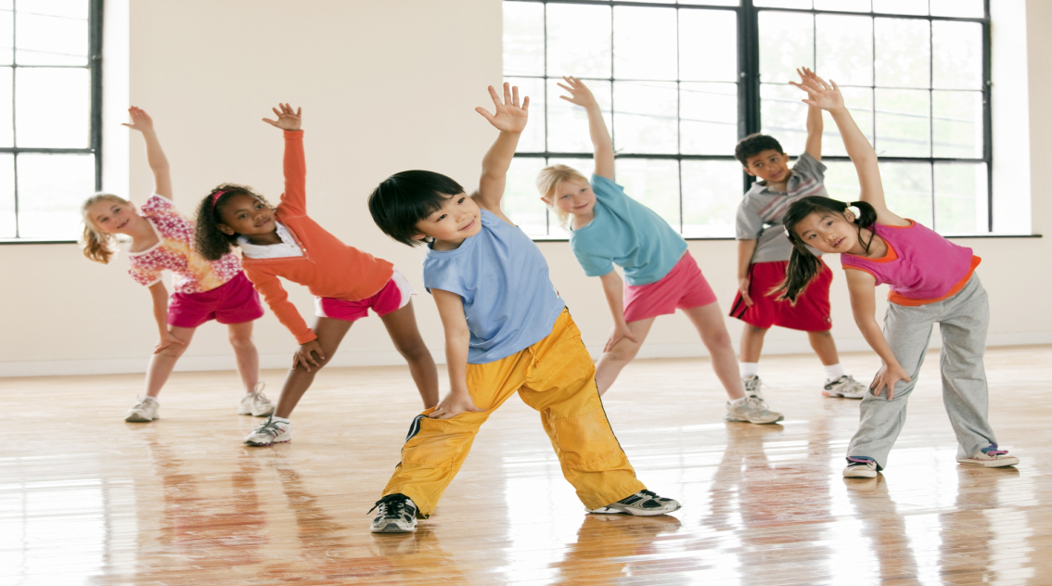

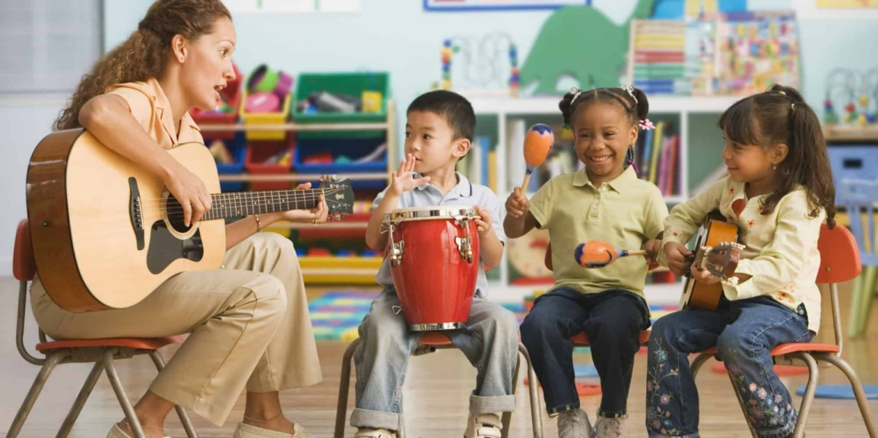
LEARN NEW WORDS
1- Music ( n )
môn nhạc
2- Physical education ( n )
môn thể dục
3- Physics ( n )
môn vật lí

Slide 10
3.LISTEN AND WRITE. COMPLETE THE SCHEDULE:
Math
English
Music
History
Physics
Friday
7.00
7.50
8.40
9.40
10.30
English
Geography
Music
Physics
History
Saturday
1.00
2.40
3.40
4.30
Physical
Education
Math
English
Physics

Slide 11
What time do you learn English ?
Now look at the picture, tell about Lan’s activities.

Slide 12
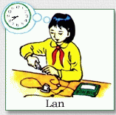
What _____ Lan ________?
She __ ________ _______
________ _____ Lan _____ her ___________?
- She ____ her ___________at ____
is
doing
is
studying
Physics
What time
does
have
Physics class
has
Physics class
8.40

Slide 13
A4
REMEMBER
1) What is she studying?
S+ is/ am/ are+ Ving.
She is studying English.
2) What time does Nam have English class?
Lan
He has his English class at 8:30.
She
her

Slide 14
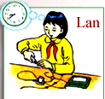


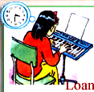
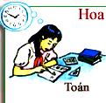
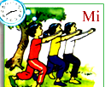
A4. Look at the pictures. Ask and answer questions
10.10
9.20
8.40
3.30
1.50
2.40

Slide 15
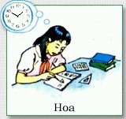
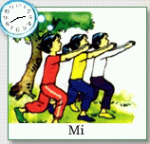

THEME 4 – AT SCHOOL Lesson 1: A_{1, 2, 4}
New words:
Physics (n)
Physical Education (n)
Math (n)
Geography (n)
a class
Môn Vật lý
Môn Thể dục
Môn Toán
Môn Địa Lý
Giờ học

Slide 16
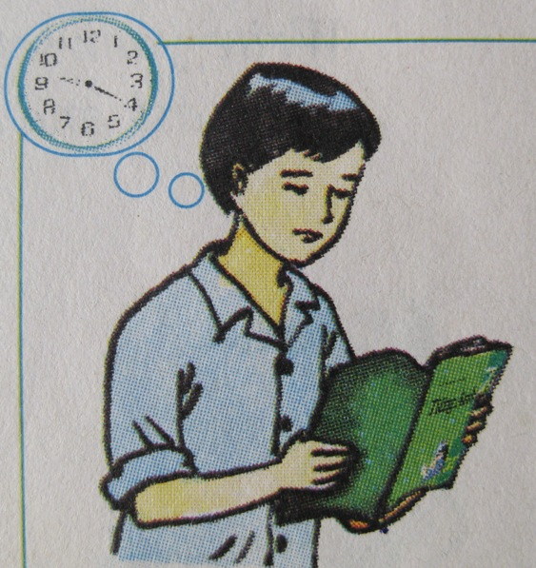
Hung

Slide 17

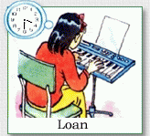
Lesson 1: A1, 2, 4
EX: What time does Binh have his Geography class?
_ He has his Geography class at 10.10

Slide 18
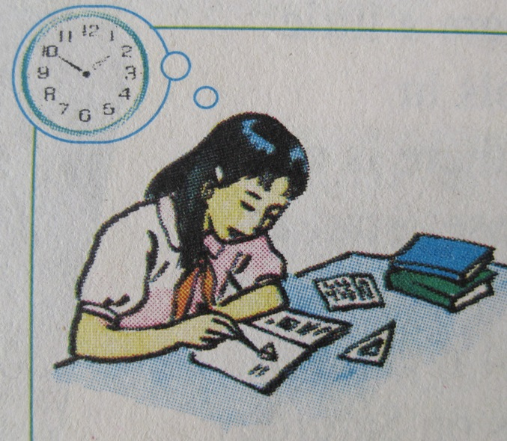
Hoa

Slide 19
EX: What time does Binh have his Geography class?
_ He has his Geography class at 10.10

Slide 20
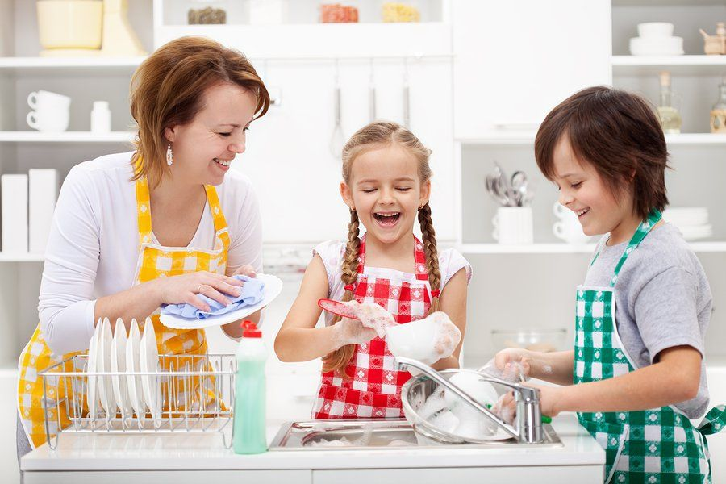

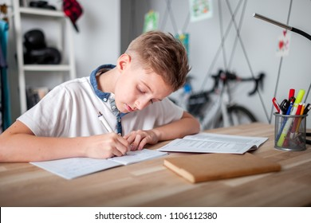
1. TALK ABOUT YOUR SCHEDULE
Ex: - I have English on Monday and Tuesday
-> I have……… on ……….
2. USING THE PRESENT PROGRESSIVE TENSE TO TALK ABOUT THESE PICTURES

Slide 21
HOMEWORK
Write the questions and answers A2, A4 p42,43 into your notebooks.
Learn about saying the time.

